Slide 1
TEAM RAPID RESQ

Slide 2
TEAM DETAILS
Members:
Eshaan Matthew Kuttikad
Taher Hotelwala
Radha Sarda
Dharmil Gathani College: K.J. Somaiya College of Engineering

Slide 3
Introduction:
The Smart City Sentinel is a modular PCB designed for real-time urban environmental monitoring.
Developed using KiCad with an integrated power management system and solar panel interface.
Ensures seamless sensor interfacing, efficient power usage, and real-time data transmission.

Slide 4
Effective delivery techniques
Dust Sensor: Monitors air quality by detecting particulate matter.
Hall Effect Sensor: Detects magnetic field variations, useful for traffic analysis.
MAX471 Current & Voltage Sensor: Monitors energy consumption and efficiency.
Water Flow Sensor: Measures water distribution efficiency in urban areas.
DHT11 Temperature & Humidity Sensor: Provides environmental data for analysis.
Soil Moisture Sensor: Assesses urban greenery and water conservation efforts.
Relay Module: Controls connected actuators for automation.
Rain Sensor: Detects rainfall for weather-based analytics.
RTC DS3231 Module: Maintains accurate timekeeping for data logging.

Slide 5
Effective delivery techniques
Voltage Booster: Regulates power for different components.
Dust Sensor: Monitors air quality by detecting particulate matter.
Hall Effect Sensor: Detects magnetic field variations, useful for traffic analysis.
MAX471 Current & Voltage Sensor: Monitors energy consumption and efficiency.
Water Flow Sensor: Measures water distribution efficiency in urban areas.
DHT11 Temperature & Humidity Sensor: Provides environmental data for analysis.
Soil Moisture Sensor: Assesses urban greenery and water conservation efforts.
Relay Module: Controls connected actuators for automation.
Rain Sensor: Detects rainfall for weather-based analytics.
RTC DS3231 Module: Maintains accurate timekeeping for data logging.

Slide 6
Power Management in PCB
Solar Panel Integration: Provides renewable power to the system.
Battery Management: TP4056 ensures safe charging and discharging.
Voltage Booster & Regulation: Maintains stable power supply for sensors and PCB.
Current & Voltage Monitoring: MAX471 ensures optimal power usage.
Low-Power Optimization: Ensures efficient energy consumption for long-term sustainability.

Slide 7
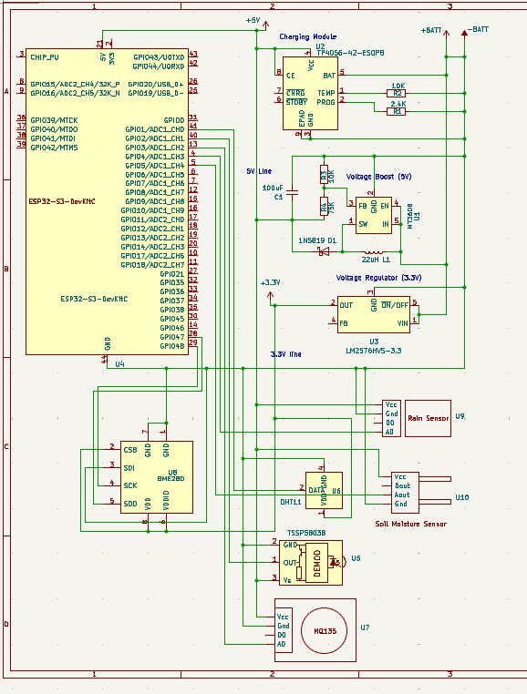
PCB Designing Process in KiCad
Component Selection: Sensors, microcontroller, and power units placed strategically.
Schematic Design: Electrical connections and communication protocols mapped.
Layout Design: Optimized component placement for efficiency and modularity.
Routing & Tracing: Ensured minimal interference and signal integrity.
Design Validation: Checked for errors and optimized for manufacturing feasibility.

Slide 8
PCB Designing Process in KiCad

Slide 9
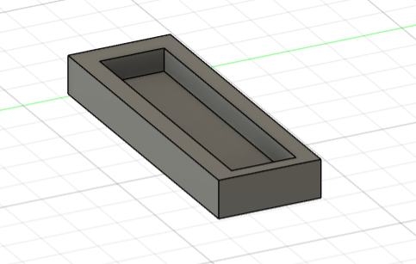
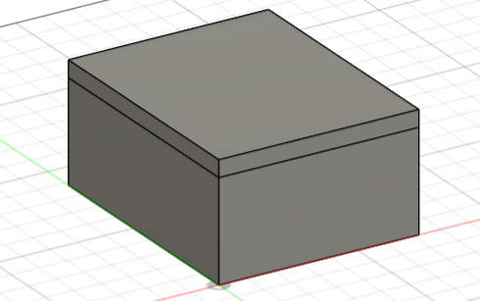
Dynamic delivery
Complete 3D CAD Design:
Ensures accurate placement of all components.
Provides a structural fit for easy assembly and scalability.
Solar Panel CAD Model:
Designed for optimal alignment with the PCB.
Supports efficient energy capture and integration.
Structural Analysis: Ensures robustness and durability in urban environments.

Slide 10
Thank you
TEAM RAPID RESQ

